Slide 1
The Battle of Plassey, 1757
The Battle of Plassey was fought on 23 June 1757. It was fought between the Nawab of Bengal and the British East India Company in which the East India company emerged victorious. This battle led to the establishment of Company’s rule in South Asia. The battle took place at Palashi, Bengal on the banks of the Bhagirathi river, near Murshidabad, then capital of the undivided Bengal. The two forces of were Siraj-ud-Daulah, the last independent Nawab of Bengal, and the British East India Company.

Slide 2
About the Battle
Siraj-ud-Daulah had a numerically superior force (about 50,000 soldiers) and made his stand at Plassey. The British, worried about being outnumbered, formed a conspiracy with Siraj-ud-Daulah's demoted army chief Mir Jafar. Mir Jafar, Rai Durlabh and Yar Lutuf Khan thus assembled their troops near the battlefield but made no move to actually join the battle. Siraj-ud-Daulah's army was defeated by roughly 3,000 soldiers of Col. Robert Clive, owing to the flight of Siraj-ud-daulah from the battlefield and the inactivity of the conspirators.

Slide 3
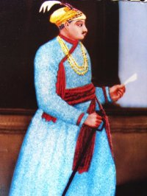
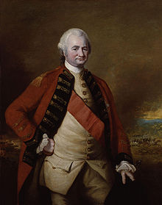
Nawab Siraj-ud-Daulah
Colonel Robert Clive

Slide 4
Causes of the Battle
Disputed Succession of Siraj-ud-Daula
Disrespect of Nawab by the British
British help to Siraj-ud-daula’s rivals
British Support to Shaukat Jang

Slide 5
Causes, cont..
Anti-Hindu policies of the Nawab
British alignment with discontented Hindus
Refusal of the British to stop fortifications
Misuse of trade Privileges
Affairs of Krishana Ballabh
Capture of Calcutta by the Nawab (June 20, 1756) and Black Hole tragedy
Re-occupation of Calcutta by the British Jan 1757
Treaty of Aliinagar
Capture of Chander Nagar (French centre)
Immediate Cause (Conspiracy against Siraj-ud-Daula)

Slide 6
Black Hole Incident
The Black Hole of Calcutta was a small dungeon in the old Fort William, at Calcutta, India, where troops of the Nawab of Bengal, Siraj ud-Daulah, held British prisoners of war after the capture of the Fort on June 19, 1756.
One of the prisoners, John Zephaniah Holwell, claimed that following the fall of the fort, British and Anglo-Indian soldiers and civilians were held overnight in conditions so cramped that many died from suffocation, heat exhaustion and crushing. He claimed that 123 prisoners died out of 146 prisoners held.

Slide 7
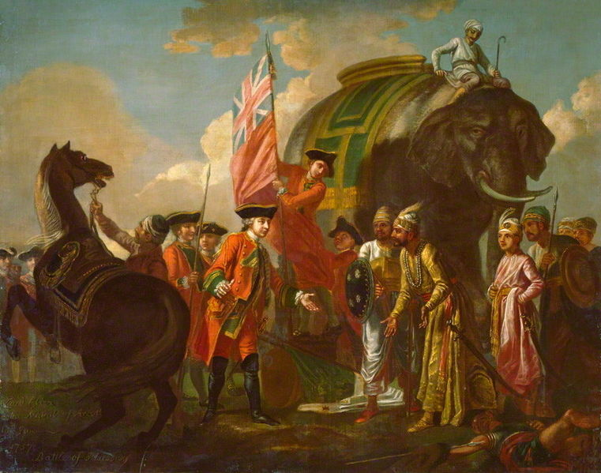
Lord Clive meeting with Mir Jafar after the Battle of Plassey

Slide 8
Significance of the Battle
No military significance
A decisive historic battle
Beginning of the new era
Economic gains of the English
Helped in the defeat of the French

Slide 9
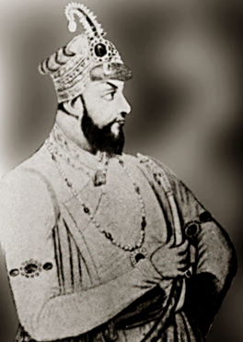
Transformation in the nature of the east India Company
The puppet government of Mir Jafar
Personal gains of Clive
Weakness of Indian Political system exposed
Opening way for new struggles
Set back to the supremacy of Mughal Emperor
Enhanced the prestige of the company.
Mir Jafar Nawab of Bengal (1757-1760)

